Slide 1
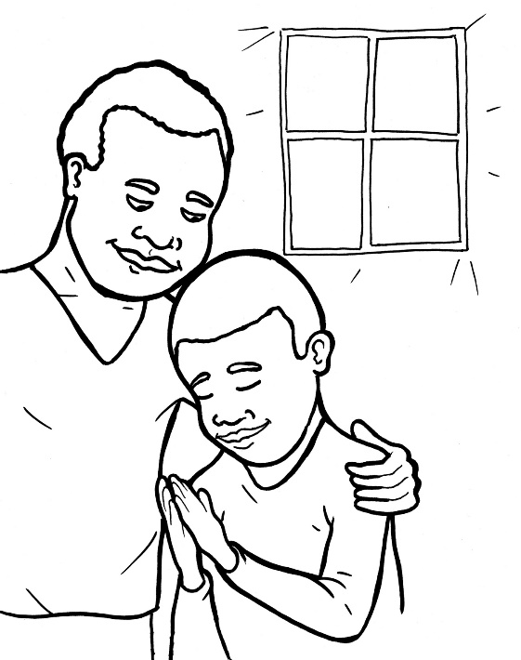

50. I am Alive: Prayer
Part 5
Vocabulary
Original Bible Story

Slide 2
Vocabulary

Slide 3
cherish
(CHER –
ish):
hold as dearly loved

Slide 4
Yahweh
(YAH -
weh):
the Hebrew name of God

Slide 5
cease
(cease):
stop

Slide 6
boldness
(BOLD -
ness):
being brave

Slide 7
grace
(grace):
special kindness

Slide 8
commandments
(com –
MAND –
ments):
God’s laws for humans

Slide 9
THESE slides ahead may need an extra timing box.
Could not leave time due to background sounds.

Slide 10
I am Alive: Prayer-I P-R-A-Y
Ephesians 6:18 and others
World English Bible (WEB)

Slide 11
When Jesus finished praying in a certain place, one of his disciples said to him, “Lord, teach us to pray...”
Luke 11:1a

Slide 12
I am sorry
If I cherished sin in my heart, the Lord wouldn’t have listened.
Psalm 66:18

Slide 13
Praise him!
Yahweh, how many are your works! In wisdom, you have made them all. The earth is full of your riches.
Psalm 104: 24

Slide 14
Rejoice!
Always rejoice. Pray without ceasing.
In everything give thanks, for this is the will of God in Christ Jesus toward you.
1 Thessalonians 5:16-18

Slide 15
Ask him for help and for what you would like.
Let’s therefore draw near with boldness
to the throne of grace,

Slide 16
that we may receive mercy and may find grace for help in time of need.
Hebrews 4:16

Slide 17
Yes. “Yes, God, I want to obey.”
If you love me, keep my commandments.
John 14:15

Slide 18
Pray at all times in the Spirit.
Ephesians 6:18b

